Slide 1
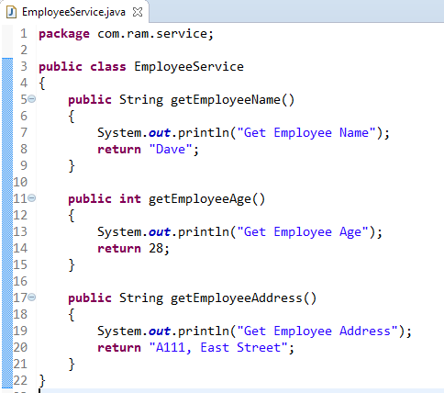
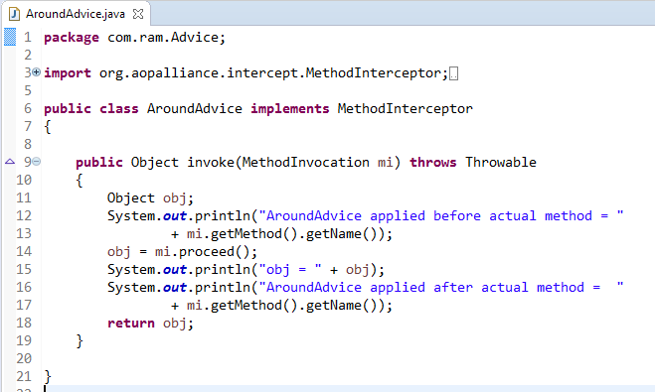
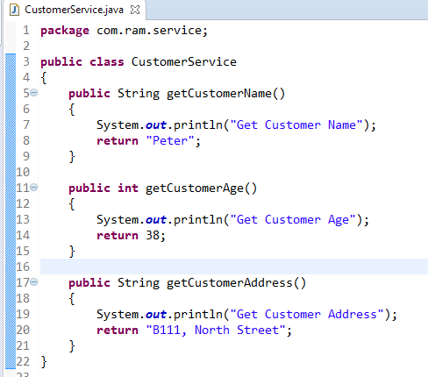
How to apply aroundAdvice for getEmployeeAge() and getCustomerAge() method.
How to apply AroundAdvice only for the method getEmployeeAge() and don’t apply for other methods?
We can match the method via following two ways :
Name match
Regular repression match

Slide 2
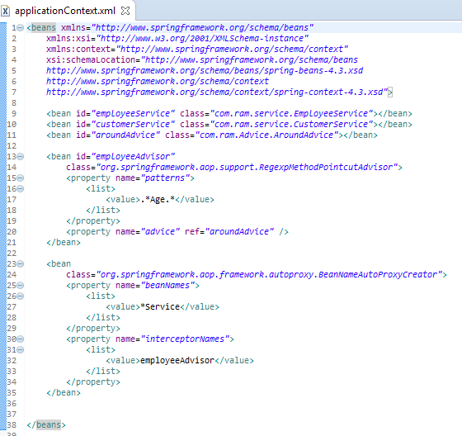
Spring comes with two auto proxy creators[
1. BeanNameAutoProxyCreator
2. DefaultAdvisorAutoProxyCreator]
to create proxies for your beans automatically.
In auto proxy mechanism, we just need to create a BeanNameAutoProxyCreator, and include all your beans (via bean name, or regular expression name) and ‘advisor’ into a single unit.

Slide 3
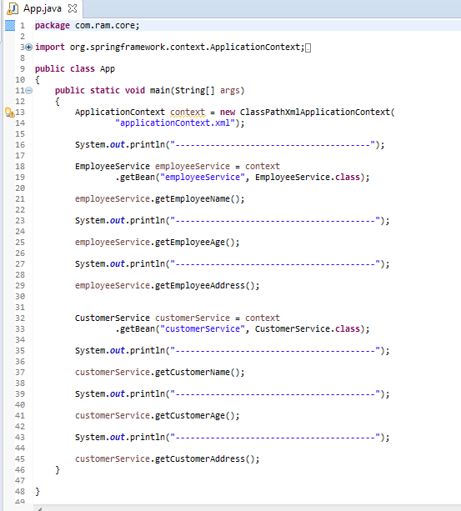

Slide 4
